Slide 1

Conservation science (196.315) Reserve selection
Jeffrey Hanson

Slide 2
Now
Biodiversity
Status quo
2000
Future

Slide 3
Now
How do we
bend the curve ?
Biodiversity
Status quo
2000
Future

Slide 4
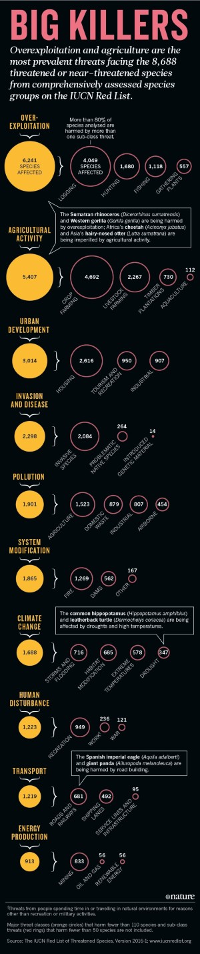
Global drivers of biodiversity loss
Maxwell et al. (2016) Nature, DOI:10.1038/536143a

Slide 5
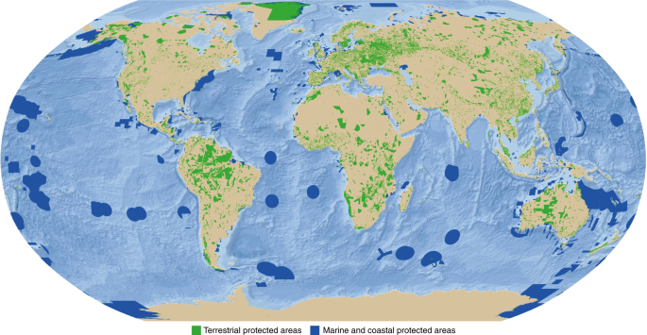
Protected areas
Bingham et al. (2019) Nature Ecology and Evolution, DOI: 10.1038/s41559-019-0869-3

Slide 6



Observations
Statistical models
Priority areas
Biodiversity
2000
Future
Data
Information
Plan
Outcome

Slide 7
Observations
Statistical models
Priority areas
Biodiversity
2000
Future
Data
Information
Plan
Outcome
Better
plan
Better
outcome
Prioritization

Slide 8
Systematic conservation planning
“Systematic conservation planning aims to provide a rigorous, repeatable, and structured approach for designing new protected areas that efficiently meet conservation objectives”
Schuster et al. (2020) PeerJ, DOI:10.7717/peerj.9258

Slide 9
Reserve selection
Planning units
Discrete places for conservation management
Each planning unit is managed separately
Commonly include land parcels, islands, spatial grid cells
Notes:
- not all remaining habitat can be preserved
- achieve conservation objectives for minimal cost
- modern systematic conservation planning primarily focusses on representing species
- however, this ignores intra-specific biodiversity

Slide 10





Reserve selection
Features
Stuff that we care about
Each feature is relatively independent
Commonly include species, ecosystem types, ecosystem services (e.g., water provisioning, carbon sequestration)
Notes:
- not all remaining habitat can be preserved
- achieve conservation objectives for minimal cost
- modern systematic conservation planning primarily focusses on representing species
- however, this ignores intra-specific biodiversity

Slide 11
Reserve selection
Which planning units should we manage for conservation?
Notes:
- not all remaining habitat can be preserved
- achieve conservation objectives for minimal cost
- modern systematic conservation planning primarily focusses on representing species
- however, this ignores intra-specific biodiversity

Slide 12
CARE-C Principles
Comprehensive
Adequate
Representative
Efficient
Connectivity
Nielsen et al. (2023) Trends Ecol Evol, doi:10.1016/j.tree.2022.09.006

Slide 13


CARE-C Principles
Comprehensive
Adequate
Representative
Efficient
Connectivity
versus

Slide 14
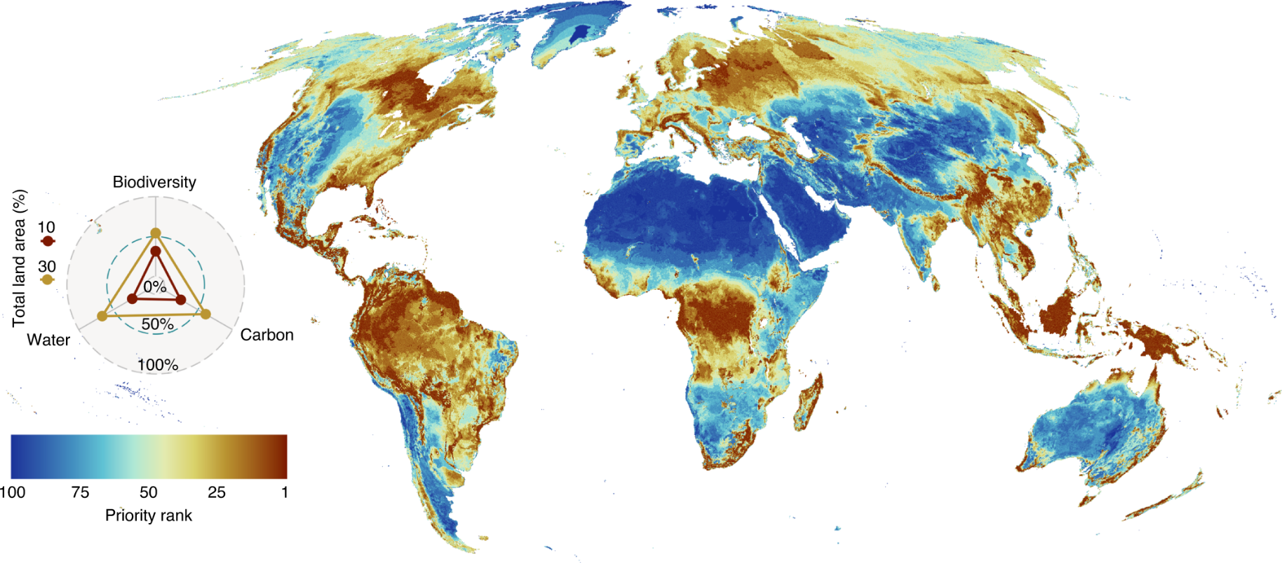
Accounting for comprehensiveness
Amphibians, mammals, birds, reptiles, plants, water provisioning, carbon sequestration
Jung et al. 2021 DOI:10.1038/s41559-021-01528-7

Slide 15
CARE-C Principles
Comprehensive
Adequate
Representative
Efficient
Connectivity
versus

Slide 16
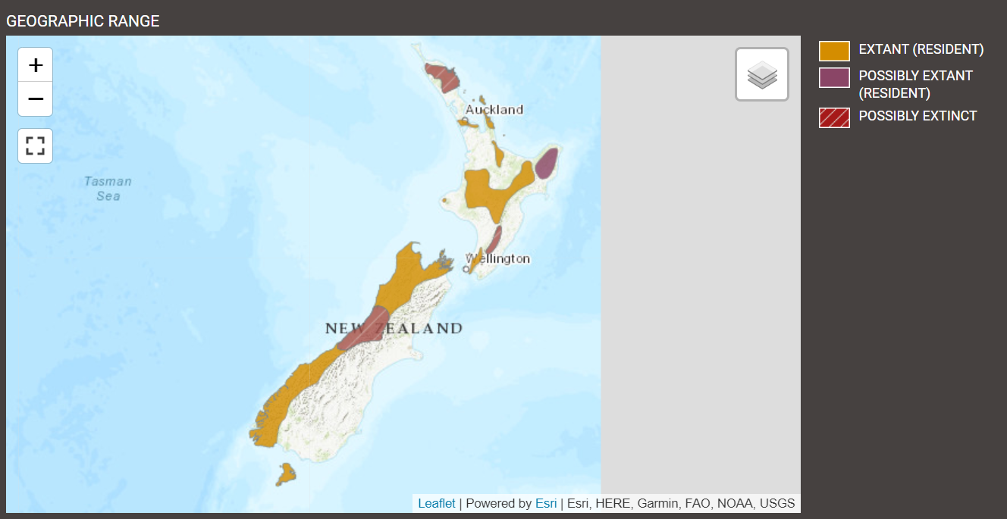
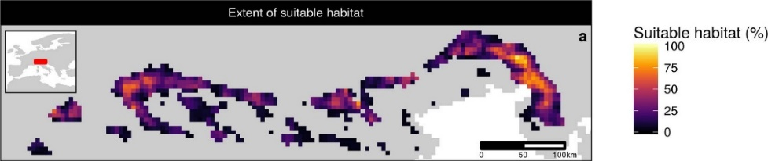
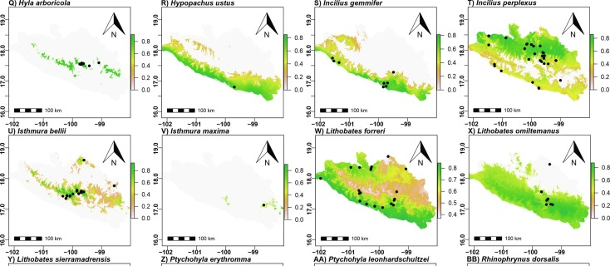
Accounting for adequacy
Get good data…
High resolution estimates of habitat suitability
Hanson et al. (2022) DOI:10.1038/s41586-020-2138-7
Species range maps
(IUCN Red List, https://www.iucnredlist.org/)
… and set good targets!
Species distribution models
González-Fernández (2022) DOI:10.1016/j.jnc.2022.126235

Slide 17
Representation targets
Policy
“In 1992, the Fourth World Congress on National Parks and Protected Areas [recommended] “that protected areas cover at least 10 percent of each biome by the year 2000” (McNeely 1993).”
“[Aichi target 11] […] targets mandate that 17% of terrestrial areas, and 10% of coastal and marine areas should be covered by nature conservation networks […]”
Policy
“We set as a fixed target the conservation of at least 10% of grid cells occupied by a species, with a minimum of one.”
“As a habitat-specific target, we used 17% of the total number of PUs where the respective habitat occurs, adopting Aichi target 11 “
Targets
Friedrichs et al. (2018) Plos ONE, DOI:10.1371/journal.pone.0208264
Jetz et al. (2014) Current Biol, DOI:10.1016/j.cub.2014.03.011
Brooks et al. (2004) BioScience, DOI:10.1641/0006-3568(2004)054[1081:CPBTGP]2.0.CO;2

Slide 18
Representation targets
Statistical estimates/models
“We modelled […] scenarios based on […] the [population viability analysis] by Todd et al. (2016). The reserve scenarios were based on the protected area required to achieve a less than 5% chance of the Leadbeater’s Possum population falling to (or below) 500 or fewer adult females in 40 generations […]. [The worst case scenario] required the Leadbeater’s Possum reserve to be expanded to 171,345 ha.”
“We aimed to include 30% of each biodiversity feature [e.g. vegetation types, environmental domains, species distributions] while minimizing the economic cost of the system of selected areas. We set conservation targets for each feature at 30% of their pre-clearing (year 1770) extent to be consistent with international recommendations (IUCN, 2003) and to ensure that biodiversity features are represented in proportion to their natural extent”
Klein et al. (2009) Biol Cons, DOI:10.1016/j.biocon.2009.01.035
Taylor et al. (2017) Plos ONE, DOI:10.1371/journal.pone.0169629

Slide 19
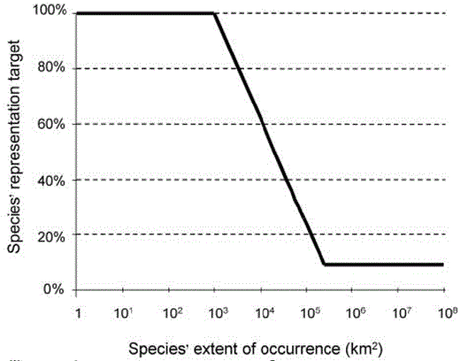
Representation targets
Expert thresholds
“Species into as many biodiversity features as the biomes in which the species occurs. We set species targets to conserving the minimum amount of species’ habitat necessary to qualify it for the conservation status ‘Least Concern’ following IUCN Red List criteria”
Jung et al. (2021) Nat Ecol Evol DO:10.1038/s41559-021-01528-7
Rodrigues et al. (2004), BioSicence, DOI:
10.1641/0006-568(2004)054[1092:GGAPRF]2.0.CO;2

Slide 20


CARE-C Principles
Comprehensive
Adequate
Representative
Efficient
Connectivity
versus

Slide 21
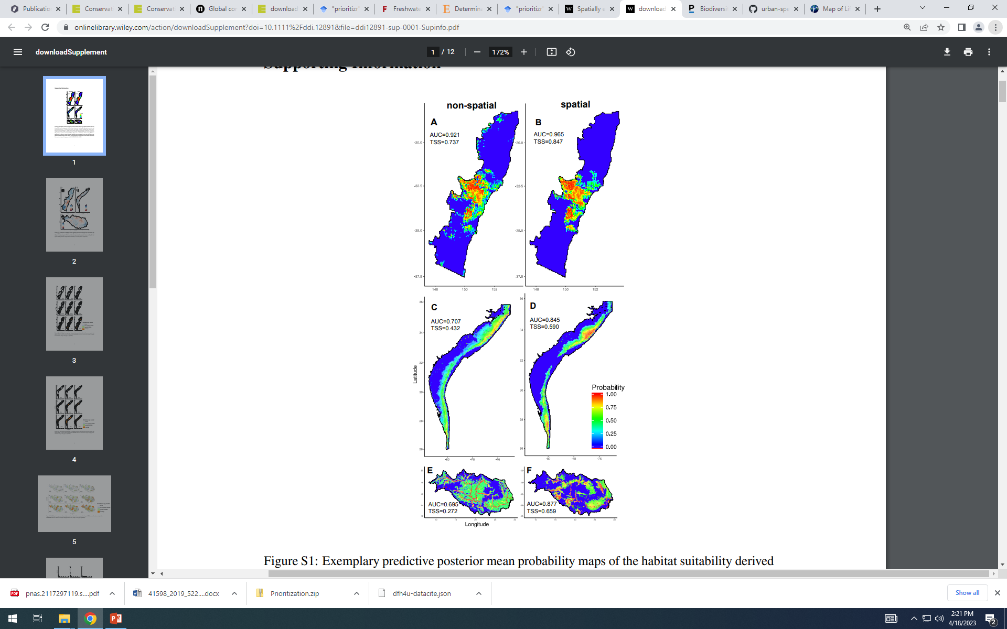
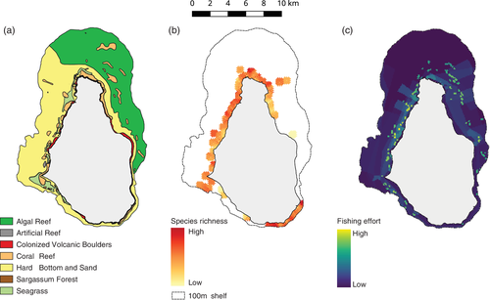
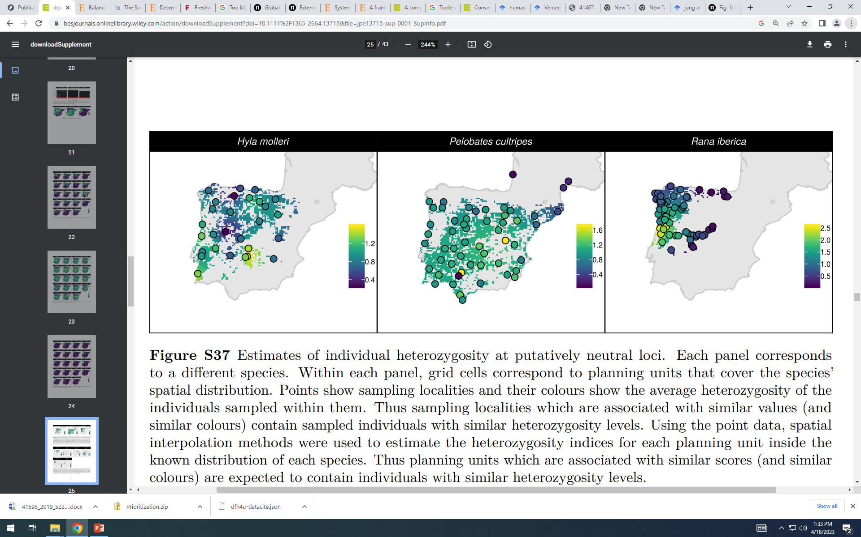
Accounting for representativeness
Species
Ecosystems
Genes
Hanson et al. (2022)
DOI: 10.1111/1365-2664.13718
Flower et al. (2010)
DOI: 10.1111/csp2.158
Domisch et al. (2019)
DOI: 10.1111/ddi.12891

Slide 22
CARE-C Principles
Comprehensive
Adequate
Representative
Efficient
Connectivity
versus

Slide 23
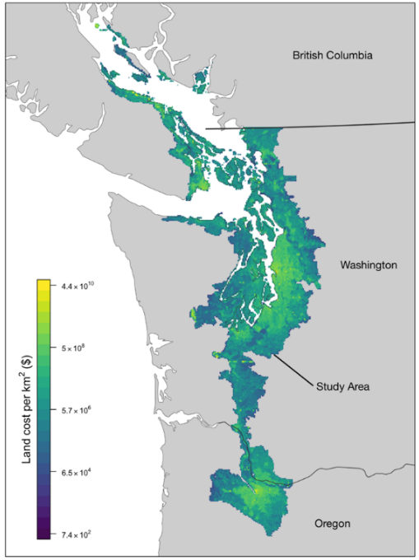
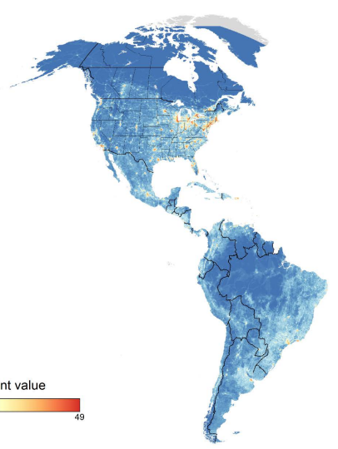
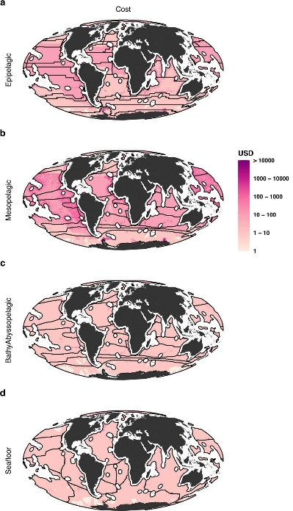
Accounting for efficiency
Land value assessments
Human pressure
Opportunity cost to commercial fisheries
Rodewald et al. (2019)
DOI:10.1038/s41598-019-52241-2
Schuster et al. (2019)
DOI:10.1038/s41467-019-09723-8
Brito-Morales et al. (2022)
DOI:10.1038/s41558-022-01323-7

Slide 24
CARE-C Principles
Comprehensive
Adequate
Representative
Efficient
Connectivity
versus

Slide 25
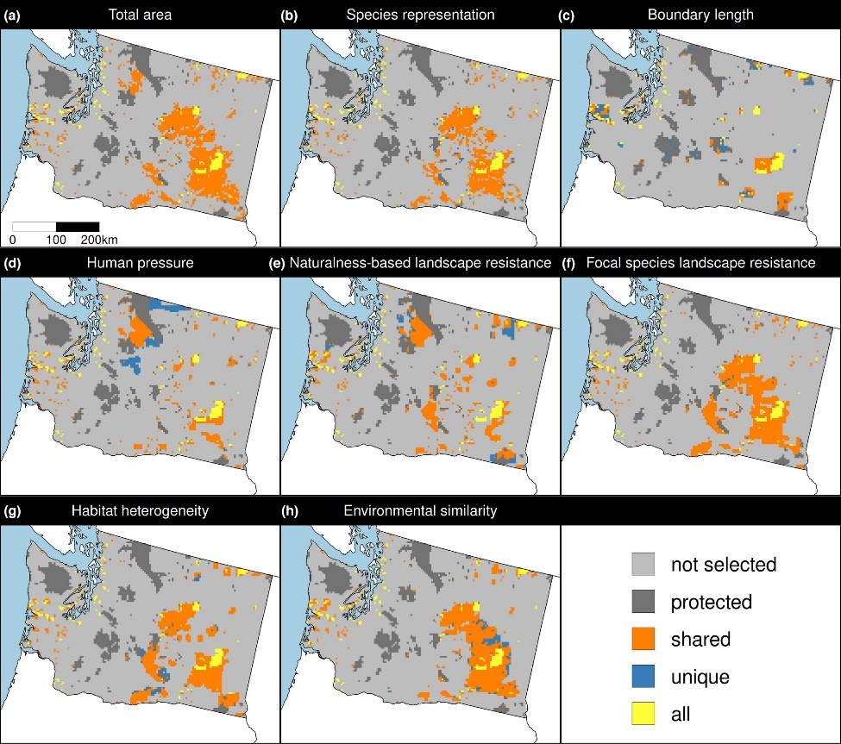
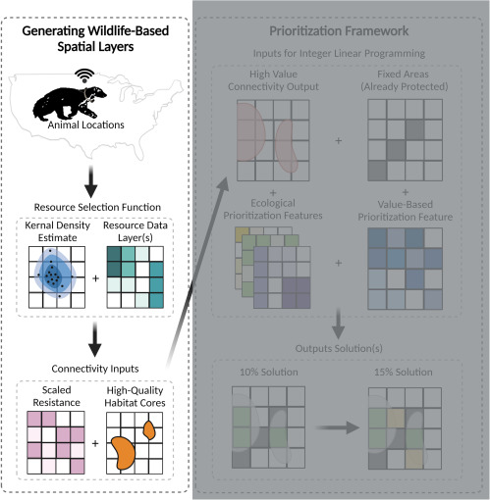
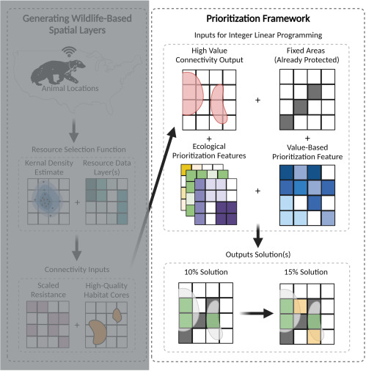
Accounting for connectivity
Carroll (2021)
DOI:10.1016/j.xpro.2021.100882
Hanson et al. (2022) DOI:10.1111/1365-2664.14251

Slide 26
Principle complementarity
Protected areas should “complement” each other to maximize the performance of the overall protected area network (including. existing protected areas)
Vane-Wright, et al (1991) Biol Cons, DOI: 10.1016/0006-3207(91)90030-D

Slide 27
But does all this stuff actually matter?

Slide 28
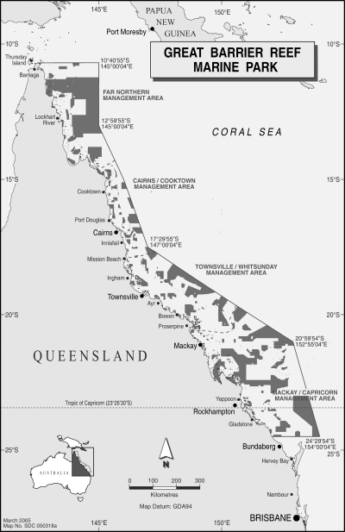
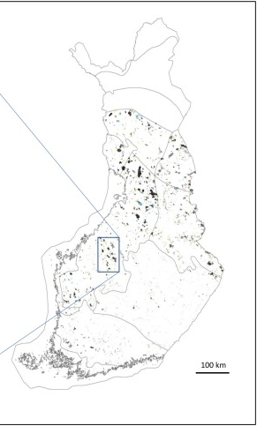
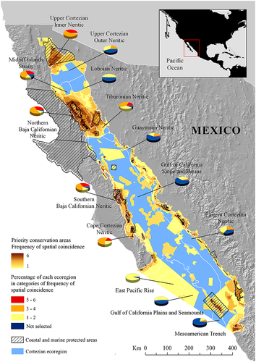
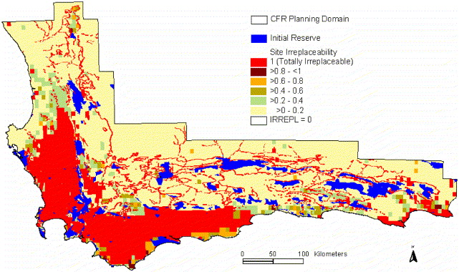
Systematic conservation planning has helped create protected areas
Australia [1]
Finland [2]
Mexico [3]
South Africa [4]
[1] Fernandes et al. (2005) Cons Biol, DOI:10.1111/j.1523-1739.2005.00302.x
[2] Kareksela et al. (2020) Biol Conser, DOI:10.1016/j.biocon.2019.108324
[3] Álvarez-Romero et al. (2013) Aquatic Conservation: Marine & Freshwater Ecosystems, DOI :10.1002/aqc.2334
[4] Cowling et al. (2003) Biol Conserv, DOI:10.1016/S0006-3207(02)00425-1

Slide 29
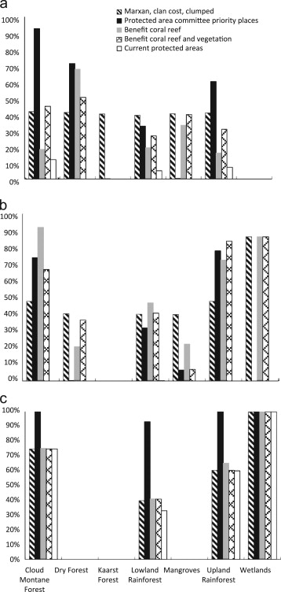
Why not have experts pick priority areas?
Klein et al. conducted study to compare approaches for identifying priority areas
Targets were to represent >= 40% of each habitat type
SCP (striped bars) selected priority areas that met all targets in cost-effectively
Experts (solid black bars) selected priority areas that were very inefficient, with some habitat types massively over-represented
Experts (solid black bars) selected priority areas that failed to meet the targets for some habitat types
Viti Levu island in Fiji
Klein et al. (2014) Marine Policy, DOI: 10.1016/j.marpol.2013.10.001

Slide 30
Framing conservation as a decision science problem
Goal: what is our vision for the future?
Objective: what quantity are we maximizing/minimizing to achieve the goal?
Constraints: what must things must we account for when implementing different actions?
Decisions: what actions can we implement to achieve our objective?

Slide 31
Framing conservation as a decision science problem
Goal: what is our vision for the future?
Objective: what quantity are we maximizing/minimizing to achieve the goal?
Constraints: what must things must we account for when implementing different actions?
Decisions: what actions can we implement to achieve our objective?

Slide 32
Reserve selection as optimization
Goal: conserve biodiversity
Objective: min. # of islands
Constraints: sufficient habitat for each species (≥ 1 island per species)
Decisions: create a reserve on an island or not?

Slide 33
Reserve selection as optimization
Goal: conserve biodiversity
Objective: min. # of islands
Constraints: sufficient habitat for each species (≥ 1 island per species)
Decisions: create a reserve on an island or not?

Slide 34
But what are the top priorities?
Irreplaceability
“[…] continuum of values between 0 and 1, where sites with values of 1 are essential for achieving one or more targets and are therefore irreplaceable.”
Carwardine etl al. (2007) Biodivers Conserv, DOI:10.1007/s10531-006-9055-4

Slide 35

But where do we start?
Vulnerability
“[…] measure of the likelihood of the biodiversity in an area being lost to current or threatening processes”
Kukkala & Moilanen (2013) Biol Rev, doi:10.1111/brv.12008

Slide 36
But what are the top priorities?
Replacement cost
“[…] loss in solution value given that the optimal cost-efficient solution cannot be protected and alternative solutions, with particular sites forcibly included or excluded, are needed”
Carbeza & Moilanen (2006) Biol Cons, DOI:10.1016/j.biocon.2006.04.025

Slide 37
But what are the top priorities?
Replacement cost
Alternate solution 1:
1 extra island needed
“[…] loss in solution value given that the optimal cost-efficient solution cannot be protected and alternative solutions, with particular sites forcibly included or excluded, are needed”
Carbeza & Moilanen (2006) Biol Cons, DOI:10.1016/j.biocon.2006.04.025

Slide 38
But what are the top priorities?
Replacement cost
Alternate solution 2:
1 extra island needed
“[…] loss in solution value given that the optimal cost-efficient solution cannot be protected and alternative solutions, with particular sites forcibly included or excluded, are needed”
Carbeza & Moilanen (2006) Biol Cons, DOI:10.1016/j.biocon.2006.04.025

Slide 39
But what are the top priorities?
Replacement cost
It’s a tie?
“[…] loss in solution value given that the optimal cost-efficient solution cannot be protected and alternative solutions, with particular sites forcibly included or excluded, are needed”
Carbeza & Moilanen (2006) Biol Cons, DOI:10.1016/j.biocon.2006.04.025

Slide 40
But what are the top priorities?
Replacement cost
$$$
Different from irreplaceability because it accounts for lost efficiency, so priorities change if we wanted to minimize total cost (instead of just number of islands)
$$$
$$
$
$
$
$
$
$
Carbeza & Moilanen (2006) Biol Cons, DOI:10.1016/j.biocon.2006.04.025

Slide 41
But what are the top priorities?
Replacement cost
$$
$$
Different from irreplaceability because it accounts for lost efficiency, so priorities change if we wanted to minimize total cost (instead of just number of islands)
$$$
$$
$
$
$
$
$
$
$
Carbeza & Moilanen (2006) Biol Cons, DOI:10.1016/j.biocon.2006.04.025

Slide 42



Decision support tools
Zonation
Marxan
Prioritizr
Best suited for budget-limited problems
Heuristic algorithm
Trade-off curves for different species
Lots of built-in ways to handle connectivity
www.github.com/cbig/zonation-core/releases
Best suited for minimum set problems
Simulated annealing algorithm
Representation targets for different species
Generates portfolios of solutions
www.marxansolutions.org
Best suited for both problem types
Exact algorithms
Representation targets for different species
Extremely customizable
R package
www.prioritizr.net
I’m one of the developers of this tool

Slide 43



Guaranteed quality
Heuristic
algorithms
Meta-heuristic
algorithms
Exact algorithms
Estimate of best solution
Quality
Different
solutions
Different
solutions
Different
solutions

Slide 44

Thanks for listening!

Slide 45
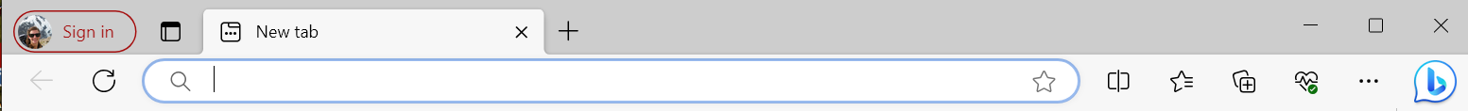
How to find a paper by DOI?
1. select a DOI
-> for example: 10.7717/peerj.9258
2. convert to a Web Address:
-> https://doi.org/ 10.7717/peerj.9258
3. copy and paste into web browser address bar

